Slide 1

Crop Yield Prediction Using Machine Learning Models

Slide 2
Members
Serial | Name | Id
1 | Sadman SHopan | 21-45205-2
2 | Md. Tamim | 22-46918-1
3 | Prithanjoly Biswas Pew | 20-43126-1
Instructor:
Mohammad Saef Ullah Miah

Slide 3

Table of Contents
Methodology
Introduction
Data Analysis
Discussion
Conclusion
Result
Literature
review

Slide 4

Introduction
Essential for food and economy
Practice of agriculture 11000 years ago (Neolithic period)
70% of the world’s available freshwater resources[1]
40% to the global rice trade from India
Reduces the wastage of water
Give the best crop production based on climate and nature

Slide 5

Literature Review
Kamir et al. [2] used SVR Model R^2 score 73%
Aghighi et al. [3] used Boosted Regression Trees Model
Kuwata and Shibasaki [4] Used deep learning (DL) and SVR models
DL model used for non-linear relationships between vegetation indicates and climatic data
RNNs model used for for rice yield prediction
Kulkarni et al. [5] utilized 31 years of soil and rainfall data and acheived an RMSE of 41.497 using Neural network model

Slide 6
METHODOLOGY
Data Collection
Exploratory Data Analysis (EDA)
Splitting The Dataset
Train ML Models
Model Evaluation

Slide 7
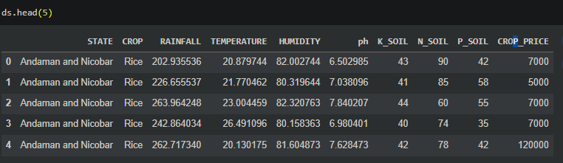
DATASET

Slide 8
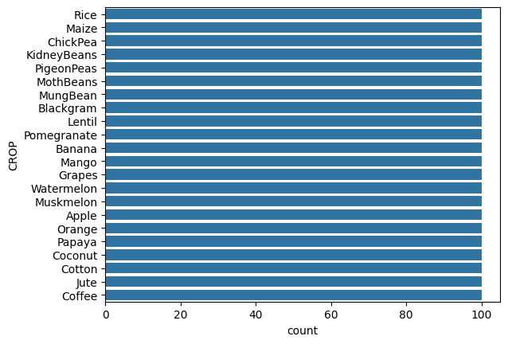
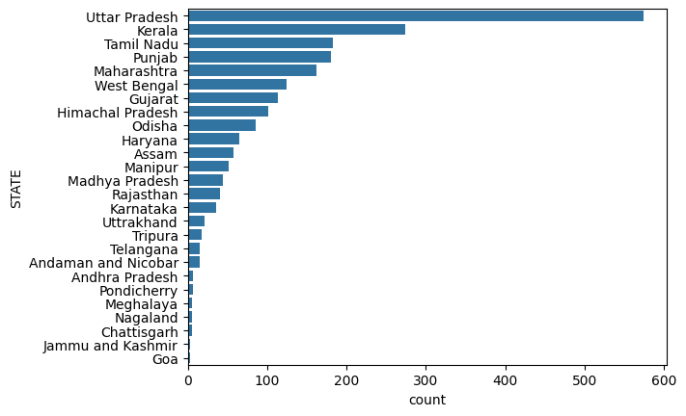
VALUE COUNT

Slide 9
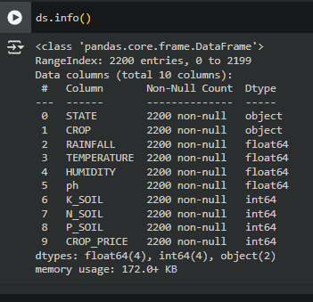
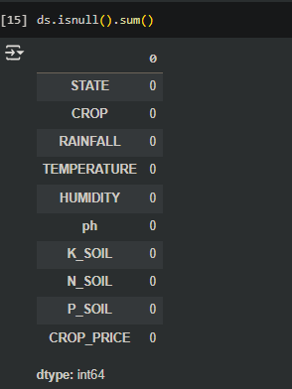
DATASET

Slide 10
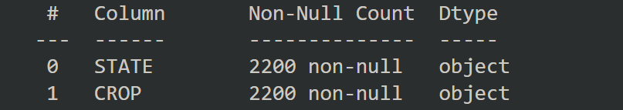
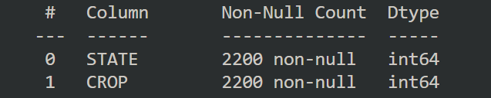
DATA ENCODING: (LabelEncoder)

Slide 11
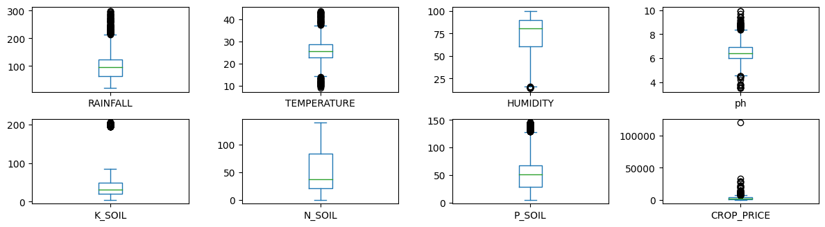
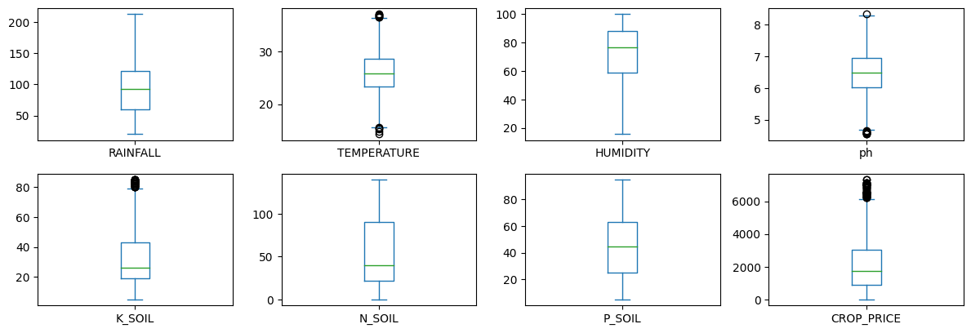
REMOVE OUTLIERS (IQR)

Slide 12
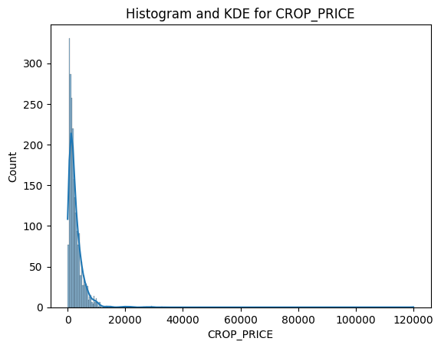
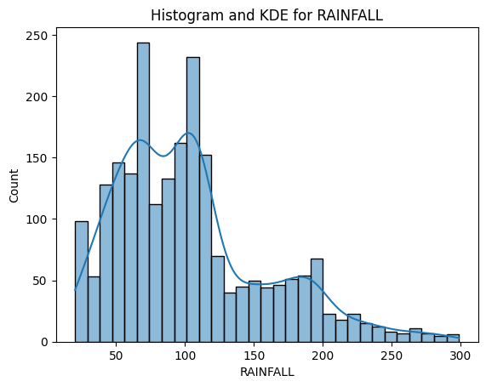
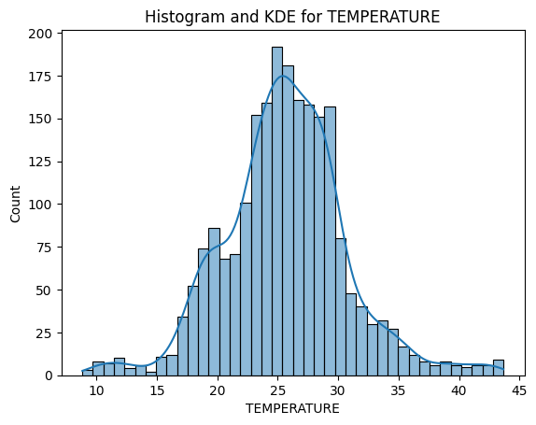
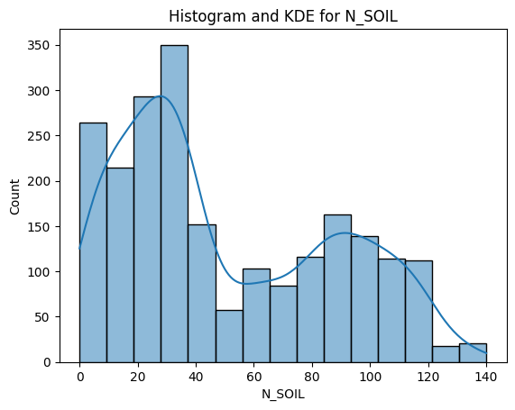
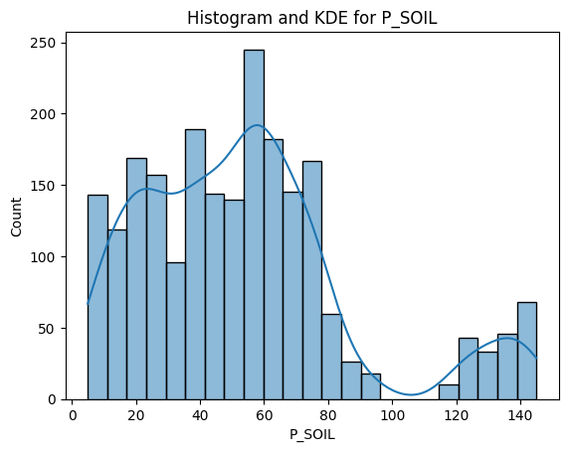
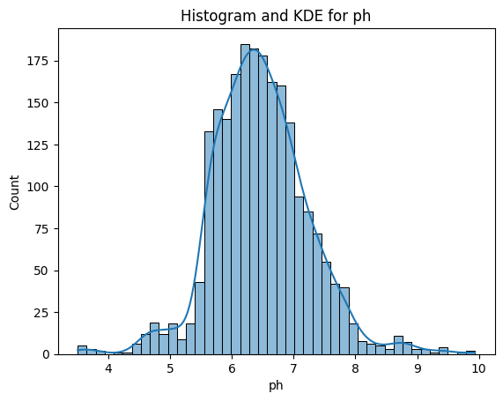
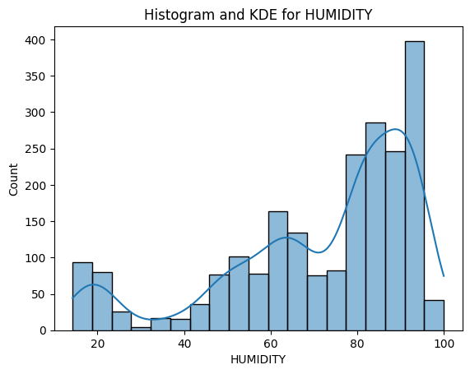
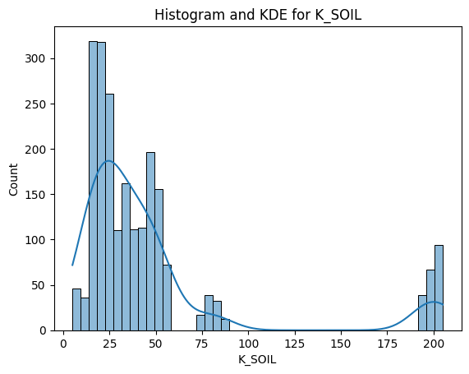
DISTRIBUTION

Slide 13
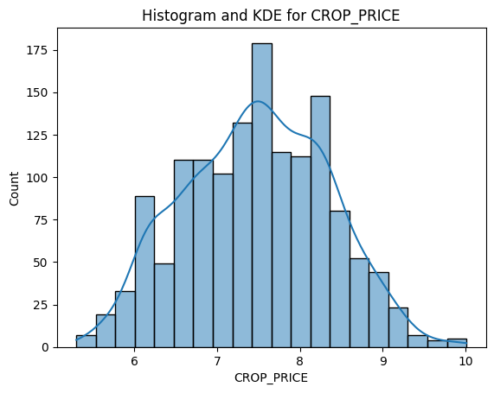
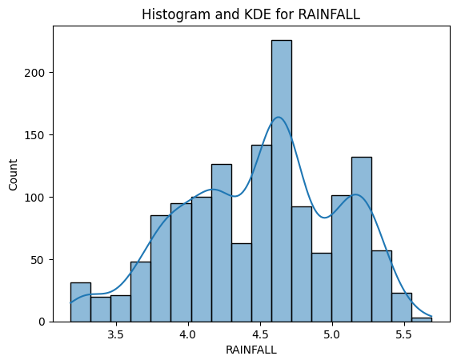
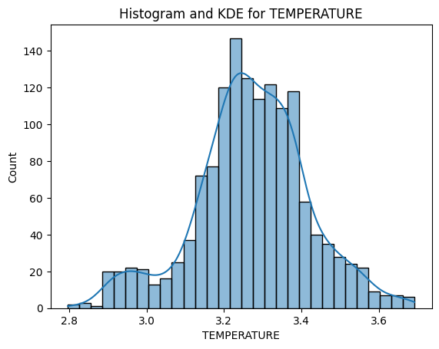
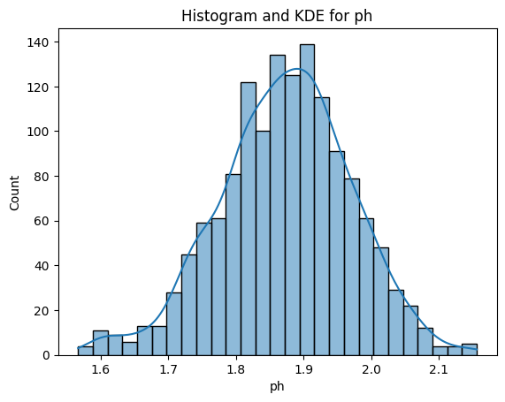
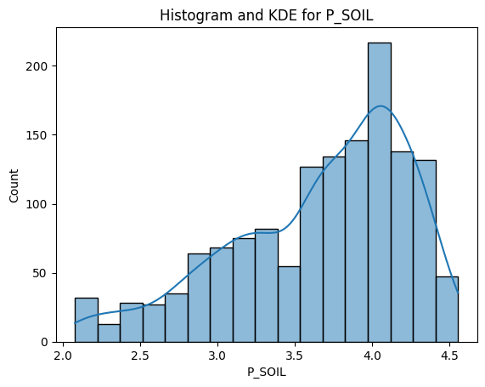
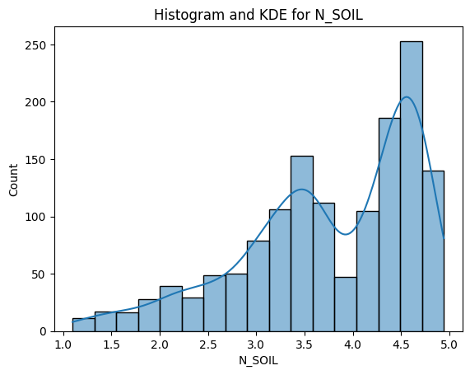
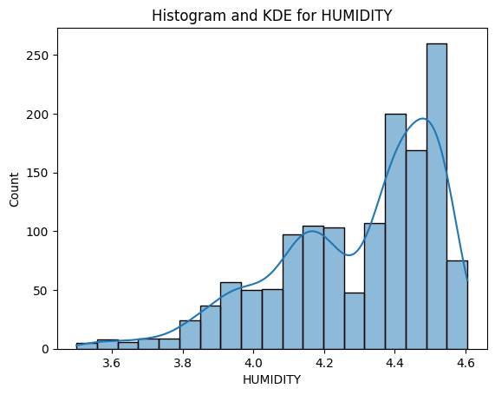
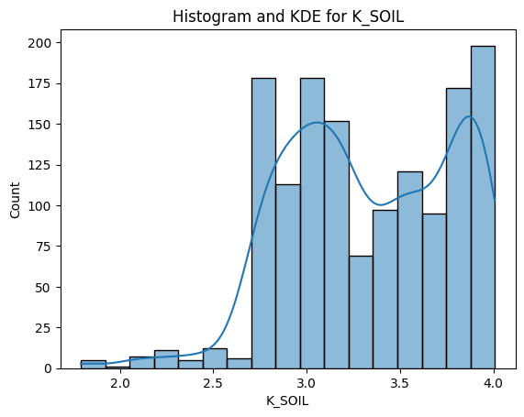
FEATURE SCALING

Slide 14
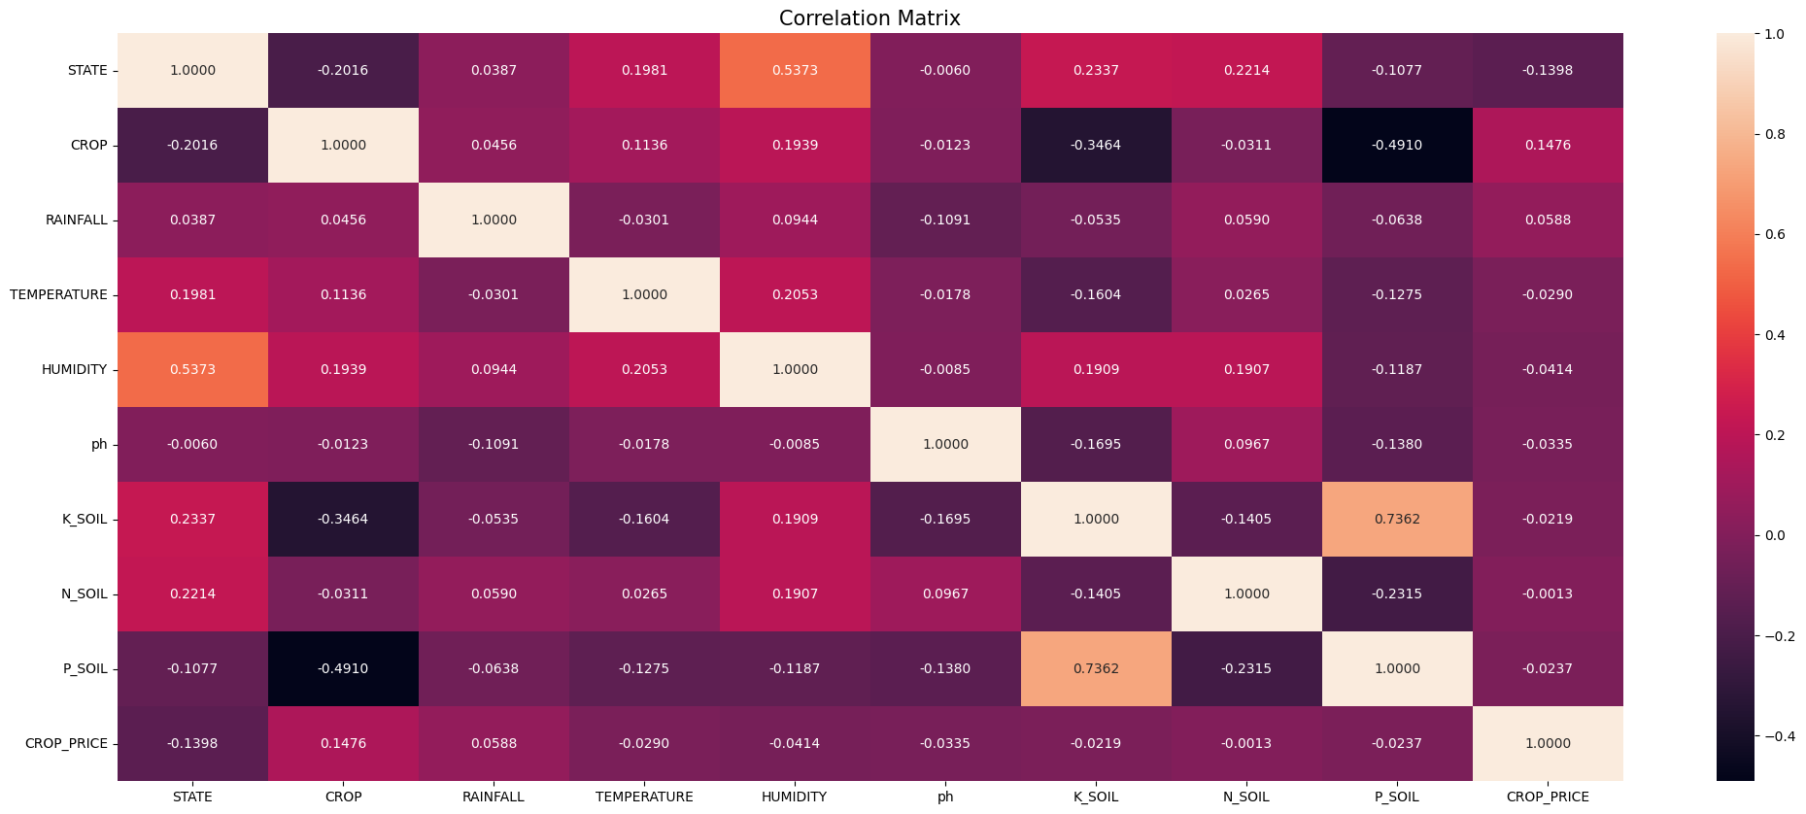
CORRELATION MATRIX

Slide 15
SPLITTING THE DATASET
Dependent Columns:
['CROP_PRICE']
Independent Columns:
['STATE', 'CROP', 'RAINFALL', 'TEMPERATURE', 'HUMIDITY', 'ph','K_SOIL','N_SOIL','P_SOIL']
TRAINING SET : 80% Data
TEST SET: 20% Data

Slide 16
Results
ML Models | Mean Absolute Error (MAE) | Root Mean Squared Error (RMSE) | Success rate (R2_score)
Decision Tree Regressor | 2359.186 | 3777.646 | 84.24%
Random Forest Regressor | 730.353 | 1132.865 | 83.43%
XGB Regressor | 2063.429 | 3424.124 | 51.38%
Extra Trees Regressor | 1948.626 | 2996.36 | 15.91%
SVR | 1653.335 | 2911.02 | 9.41%
K Neighbors Regressor | 1724.3 | 2374.177 | 17.78%
Bagging Regressor | 1798.064 | 2474.87 | 27.98%

Slide 17

Discussion
Well performed:
From the results, it is evident that some models, such as the Random Forest Regressor, Decision Tree Regressor.But others performed poorly because of:
SVR: Non-linearly separable,High amount of noise,complex dataset.
K Neighbors Regressor: Highly dimensional, lacks distinct patterns
Extra Trees Regressor: Highly complex, randomness is not balanced by sufficient data

Slide 18

Conclusion
In conclusion, machine learning models like **Random Forest** and **Decision Tree Regressor** enhance crop yield predictions by analyzing soil and environmental data. These tools help optimize farming practices and adapt to climate change, improving productivity and food security. However, their accuracy depends on data quality, emphasizing the need for further research.

Slide 19
References:
[1] M. Khan and S. Noor, ‘‘Irrigation runoff volume prediction using machine
learning algorithms,’’ Eur. Int. J. Sci. Technol., vol. 8, pp. 1–22, Jan. 2019.
[2] S. Kamir, L. Wang, and P. Khaki, "Crop yield prediction using deep neural networks," Frontiers in Plant Science, vol. 10, p. 621, May 2019.
[3] H. Aghighi, F. Omid, and B. Esmaeilpour, "Maize crop yield prediction using machine learning techniques," Environmental Modeling & Software, vol. 22, no. 6, pp. 5687–5708, Aug. 2020.
[4] M. Kuwata and R. Shibasaki, "Machine learning approach for crop yield prediction based on time-series data from satellites and climatic factors," IEEE Journal of Selected Topics in Applied Earth Observations and Remote Sensing*, vol. 7, no. 12, pp. 5070–5081, Dec. 2015.
[5] V. Kulkarni, K. Gopal, and S. S. Naik, "Rice yield prediction using time-series soil and rainfall data," International Journal of Agricultural Sciences, vol. 31, no. 2, pp. 99-110, 2020.

Slide 20

thank you

